Slide 1
Digital Design II
Mini-project I
Group:
Samah Hussein
Mohamed Shehawy

Slide 2
Overview
Project: Option 3
Verilog Netlist Enhancer
Technical background
General Design
Implementation

Slide 3

Technical background
Liberty files:
These files contain all the cells that the design compiler uses to generate the netlist, they contain specific information about these cells. the liberty file specifies the number of inputs/outputs per cell, the input pin capacitance, the area of the cell, as well as the lookup tables for each cell.
Verilog netlists:
the netlist contains the specific cells used to form a particular circuit. it specifies the types, names, sizes, inputs, outputs, and wires for each set of connections that form a circuit.

Slide 4
Technical background & Design
The project purpose:
Enhancing the provided verilog netlist to adapt to user-specified rules regarding the maximum fan-out per cell and the maximum cell delay by using 3 techniques:
Sizing up
Cloning
Buffering

Slide 5
Sizing
Sizing up cells with high fan-out reduces their delay as they can feed the high capacitive load with smaller cell delay.

Slide 6
Cloning
This technique reduces the cell delay as the capacitive load is distributed over two or more cells instead of one cell to provide for all the load. Assuming a main cell of 20 fan outs, this cell is replicated 3 more times so that there are 4 cells of this type with similar input and each of the 4 clones will feed only 5 fan-outs reducing the cell delay.

Slide 7
Buffering
Buffers are known for strengthening signals. the Buffering technique we use is to check the cells for fan-out violations and adding buffer trees at the output of these cells in order to eliminate the violation and strengthen the signal provided from these cells.
So instead of a cell having 15 fan-outs, this cell will feed directly 5 buffers and in turn each of these buffers will feed 3 of the 15 cells (assuming maximum fan-out of 5)

Slide 8
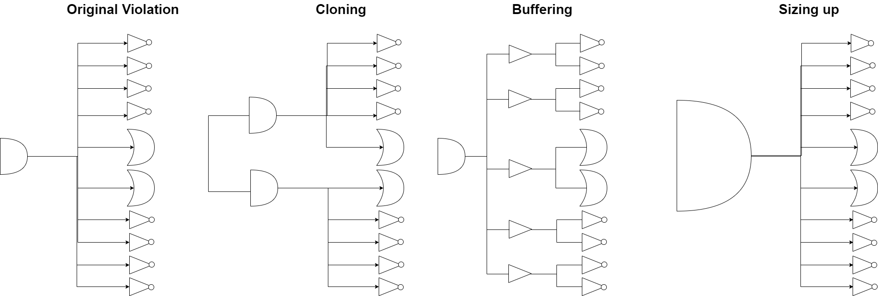
Illustrations

Slide 9
Implementation
What language did we use?
Why?
Python
Due to :
-Ease-of-use and the existence of very helpful open source parsing libraries online

Slide 10
Implementation -used libraries
Verilog-parser
Liberty-parser
This class library is object oriented. it is created as part of the project that parses verilog netlists into cells and their attributes such as inputs, outputs, cell delay and the frequency of each kind of cell.
This open source library was used to parse the liberty files associated with the netlists, it helped extract the attributes of each kind of cell, input capacitance, delay, size, etc..
Initially, this library had no how-to-use or documentation, so we created a brief explanation for it with the specific syntax on GitHub.

Slide 11
GitHub Repository:
https://github.com/Mahfouz-z/DD2_Verilog_netList_enhancer

Slide 12
Thank you!
Questions?

